Slide 1
Overview of Java Constructors
What is a Constructor?
  A special method used to initialize objects.
  Automatically called when an object is created.
Key Features:
  Same name as the class.
  No return type, not even void.
Can be default or parameterized.

Slide 2
Default Constructor
Definition:
  A constructor without parameters.
  Automatically provided by Java if no constructors are defined in the class.
Purpose:
  Initializes object with default values.

Slide 3
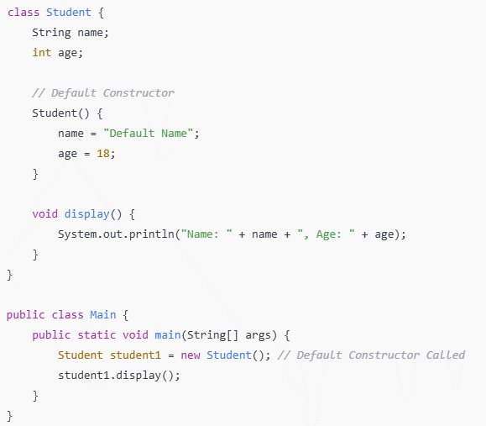
Example Code:

Slide 4
Parameterized Constructor
Definition:
  A constructor with parameters.
  Used to initialize objects with specific values.
Purpose:
  Provides flexibility to set values during object creation.

Slide 5
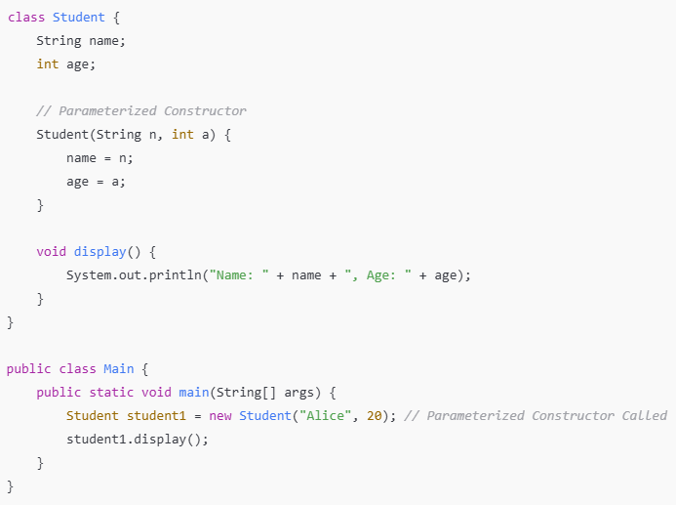
Example Code:

Slide 6
Comparison of Constructors
Aspect | Default Constructor | Parameterized Constructor
Parameters | None | Accepts parameters
Flexibility | Fixed default values | Custom values during object creation
Use Case | Basic object initialization | Advanced initialization with specific values

Slide 7
Static Variable in Java
Definition:
  A variable shared among all instances of a class.
  Declared using the keyword static.
Key Characteristics:
  Stored in the class area, not per object.
  Accessed using the class name or directly inside the class.
Advantages of Static Variable
Saves memory as it is shared across all objects.
Useful for counters, configuration values, or shared data.
Eliminates the need for duplicating variables in multiple objects.

Slide 8
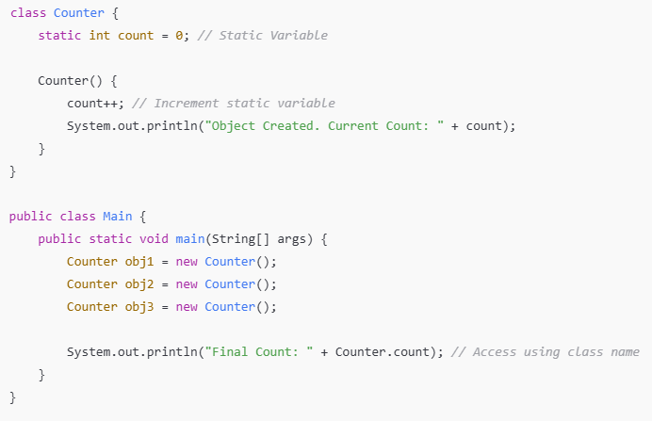
Example Code for Static Variable

Slide 9
Instance Variables
Definition:
Instance variables are declared inside a class but outside any method or constructor. Each object has its own copy.
Key Points:
  Declared in a class.
  Belong to each object.
  Default values are assigned based on the data type.

Slide 10
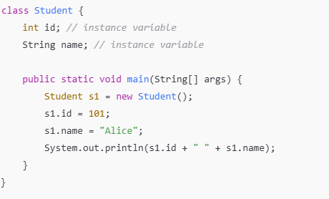
Example

Slide 11
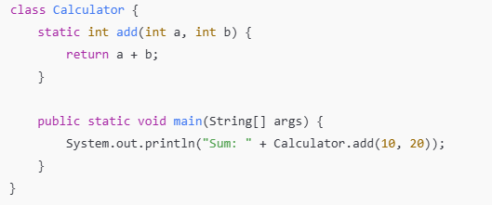
Static Methods
Definition
Methods declared with the static keyword belong to the class and can be called without
creating an object.
Key Points:
  Access only static data.
  Cannot use this or super.
  Useful for utility or helper methods.

Slide 12
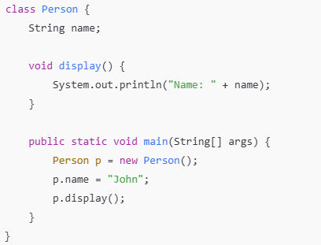
Instance Methods
Definition:
Methods that operate on the instance variables of a class.
Key Points:
  Called using an object of the class.
  Can access both instance and static variables.

Slide 13
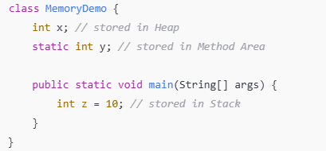
Language Fundamentals: Structure of Memory
Key Points:
  Heap Memory: Stores objects and instance variables.
  Stack Memory: Stores method calls and local variables.
  Method Area: Stores class-level data and static variables.

Slide 14
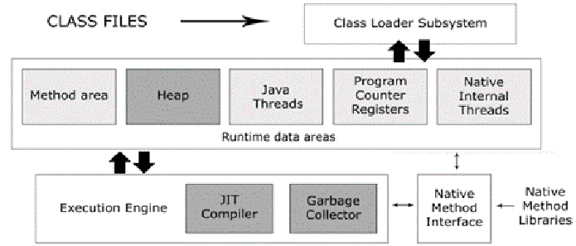

Slide 15
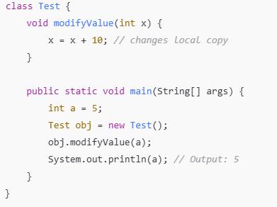
Parameter Passing in Java
Definition:
Java uses pass-by-value for both primitive and object references.
Key Points:
  For primitives: A copy of the value is passed.
  For objects: A copy of the reference is passed.

Slide 16
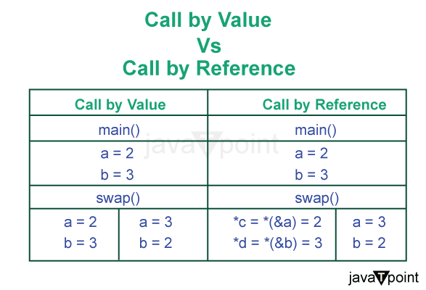

Slide 17
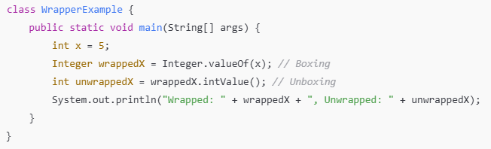
Wrapper Classes
Definition:
Wrapper classes provide a way to use primitive data types as objects.
Key Points:
  Common wrappers: Integer, Double, Boolean.
  Useful for collections and type conversions.

Slide 18
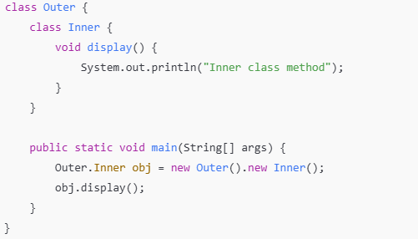
Inner Classes
Definition:
A class defined within another class.
Key Points:
  Types: Static Inner Class, Non-Static Inner Class, Local Inner Class, Anonymous Inner Class.
  Helps logically group classes.

